Slide 1


Team 36: Mesh Walkie Talkies
Bi-Weekly Update 1 Jaiah Steele, Cole Cieslewicz, Junsu Yeo Sponsor: Giuseppe Rizzi TA: Niloofar Borzooei
Notes:
Michelle

Slide 2
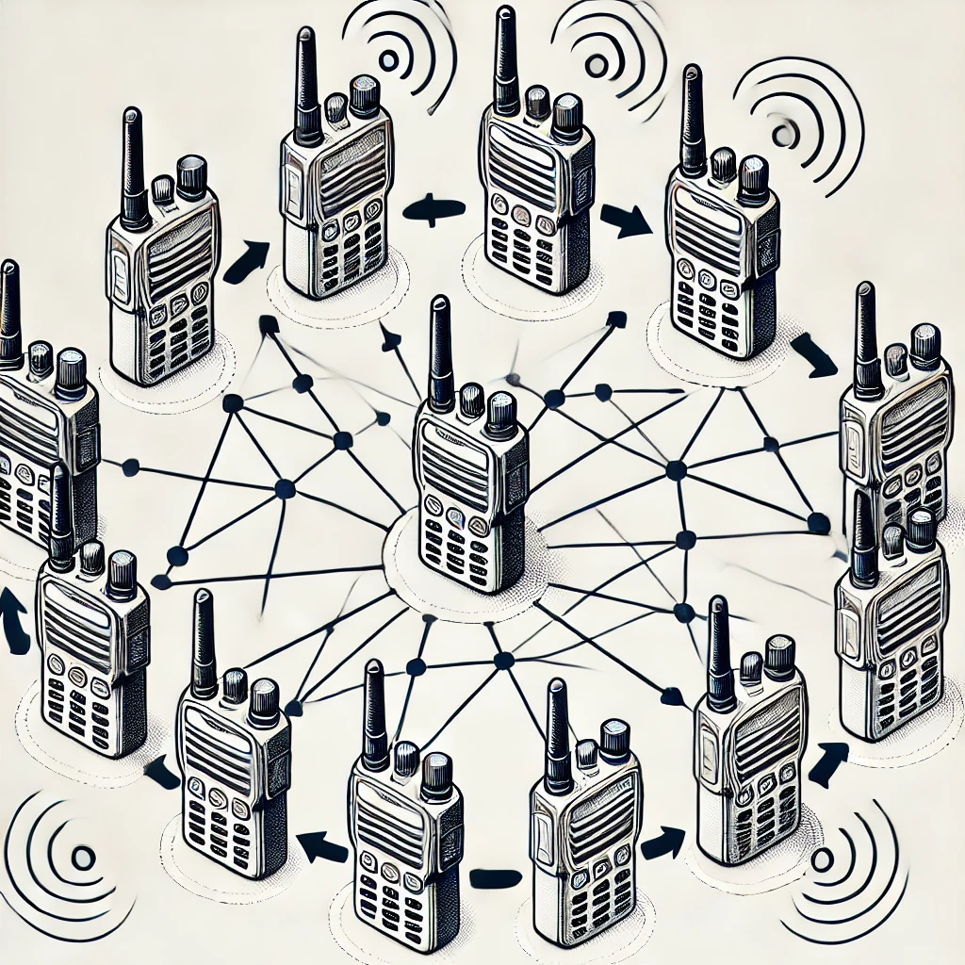
Project Summary
Conventional Walkie-Talkies:
Require close, limited communication
Not as effective for large area coordination
No network advantage
Our Solution:
Mesh network to extend range and communication reliability
Notes:
Kyle

Slide 3
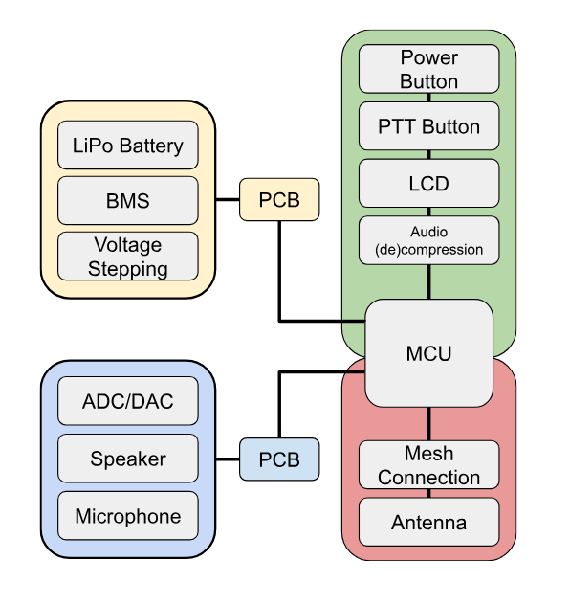
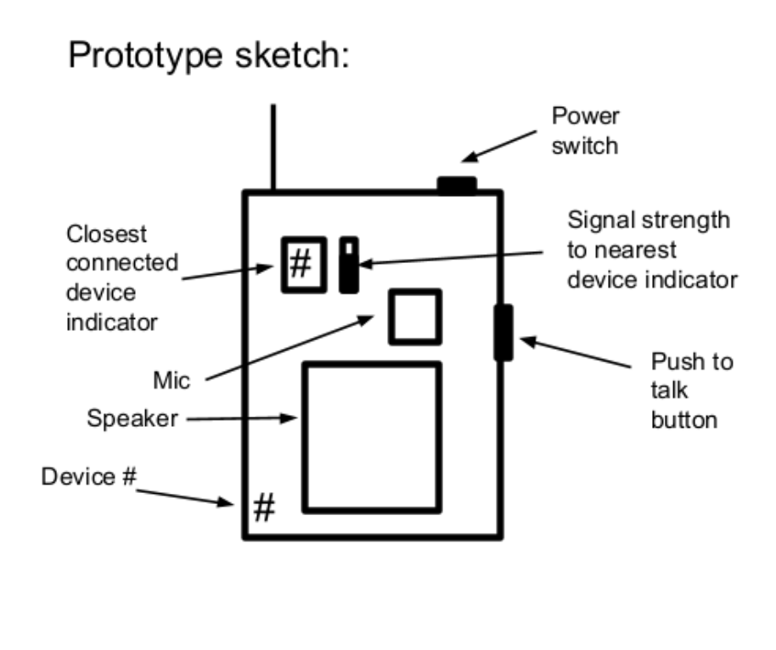
Project/Subsystem Overview
Notes:
Eric

Slide 4
Major Project Changes for 404
Team Changes:
Had a member drop during 403 (whose responsibilities were mainly audio/MCU hardware)
Members tasks were split amongst Junsu/Jaiah
Project Changes:
Launchpads vs custom PCB’s
Talk to sponsor about utilizing launchpads in final projects
Migrate from UART comm. to audio interface
Notes:
Eric

Slide 5
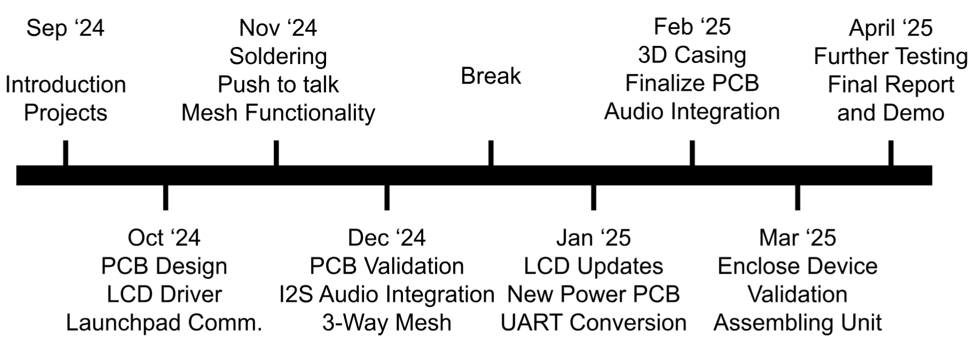
Project Timeline
Notes:
Eric

Slide 6
Push-To-Talk/Audio Functionality
Jaiah
Accomplishments since 403 3 hrs of effort | Ongoing progress/problems and plans until the next presentation
Final demo - Push-To-Talk functionality/I2s audio echo still functional. Ordered remaining parts needed: Antennas, microphones, speakers, LCD’s for 3 working sets of walkies. | Have LCD update across launchpads/verify mesh transmission. Investigate audio transmission measurements i.e sample rate (8Khz min), bits per sample (8-bit min), and bitrate of transmission.

Slide 7
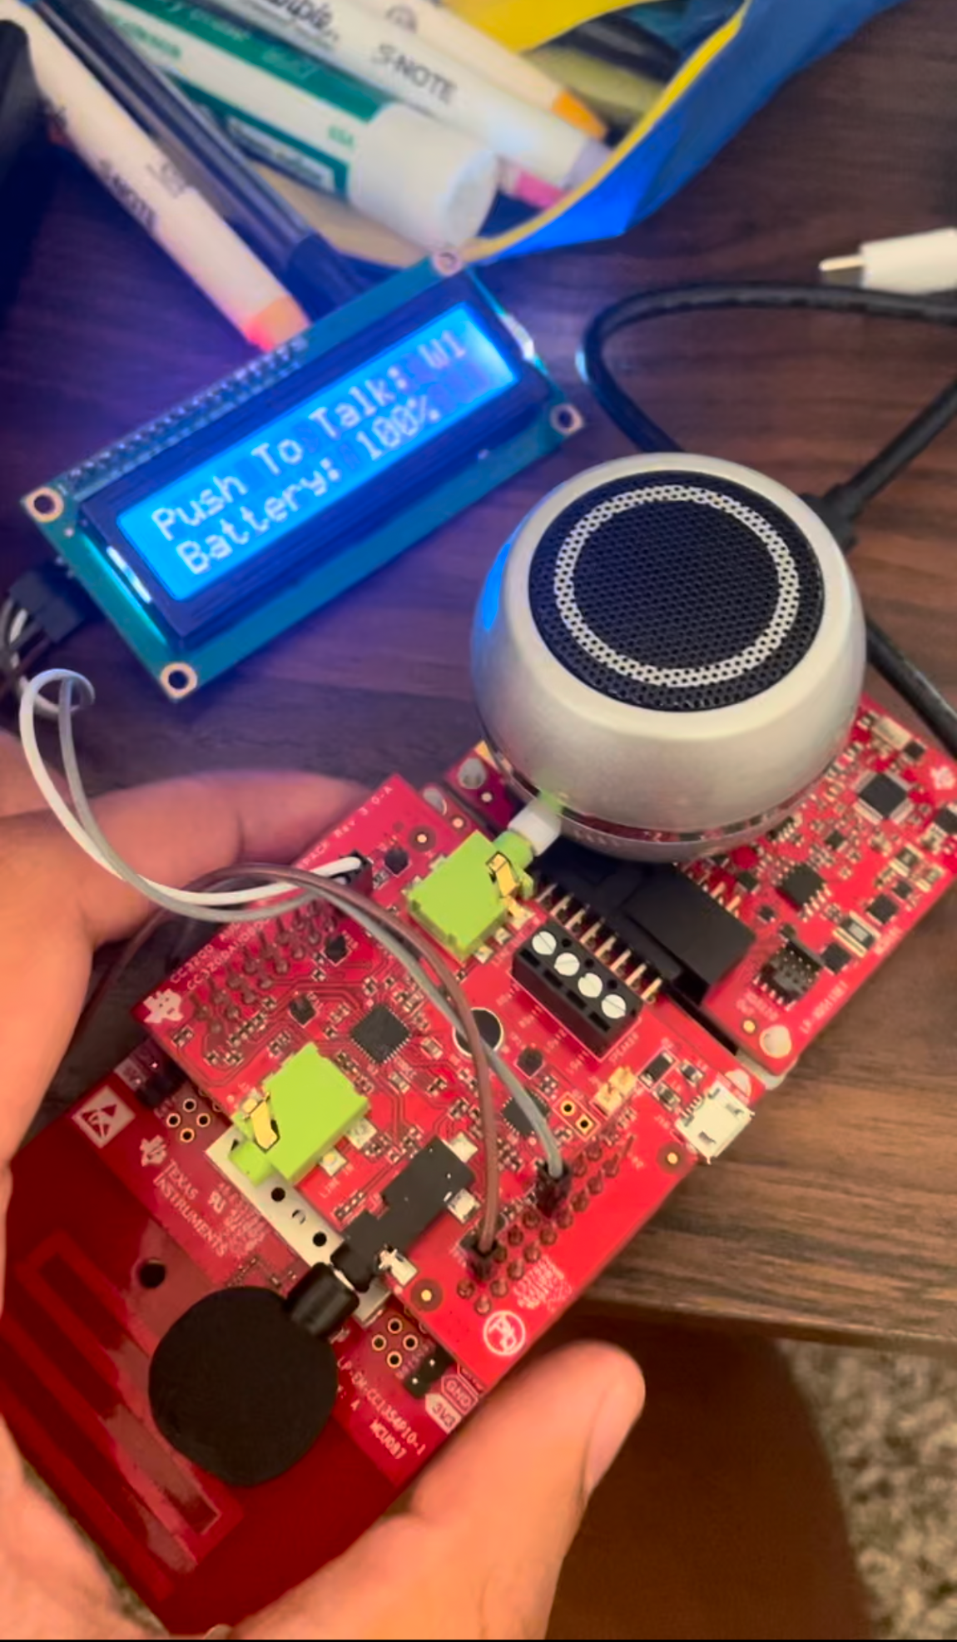
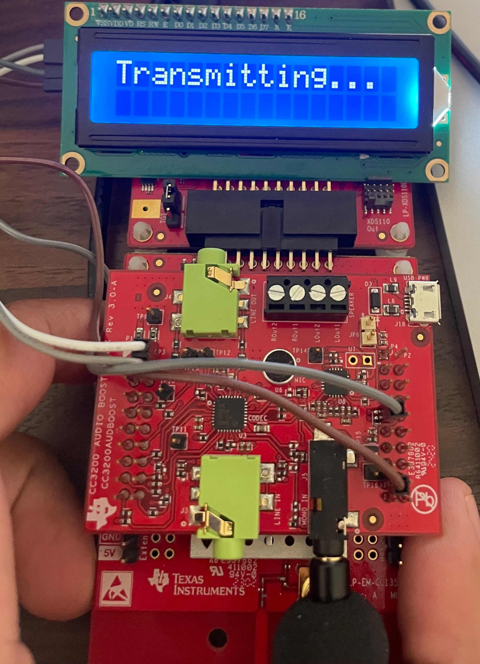
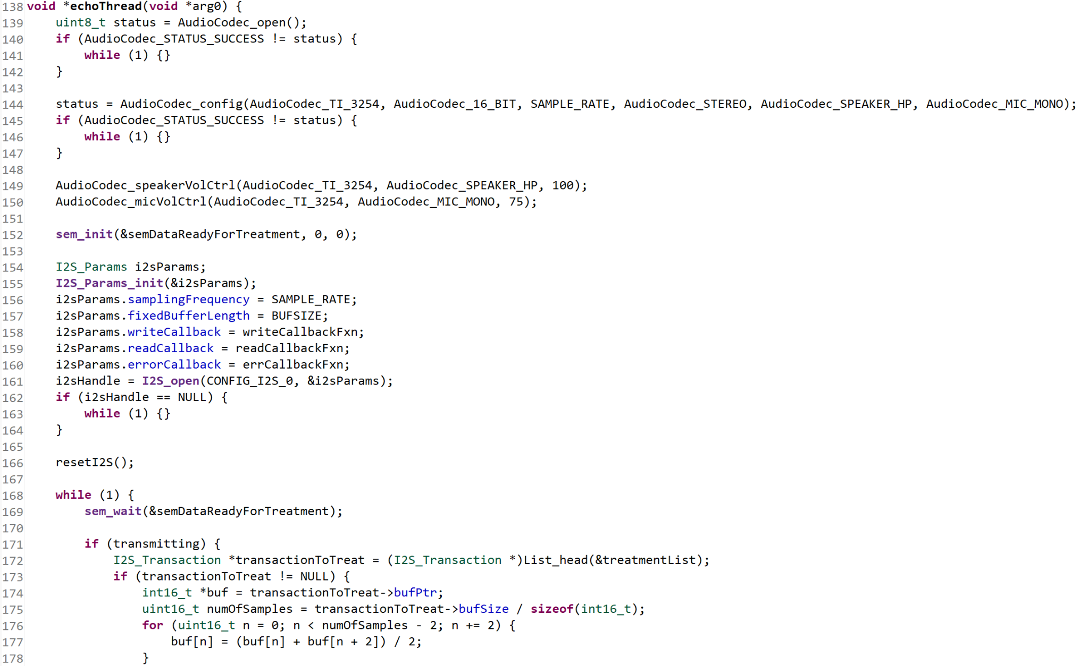

Slide 8

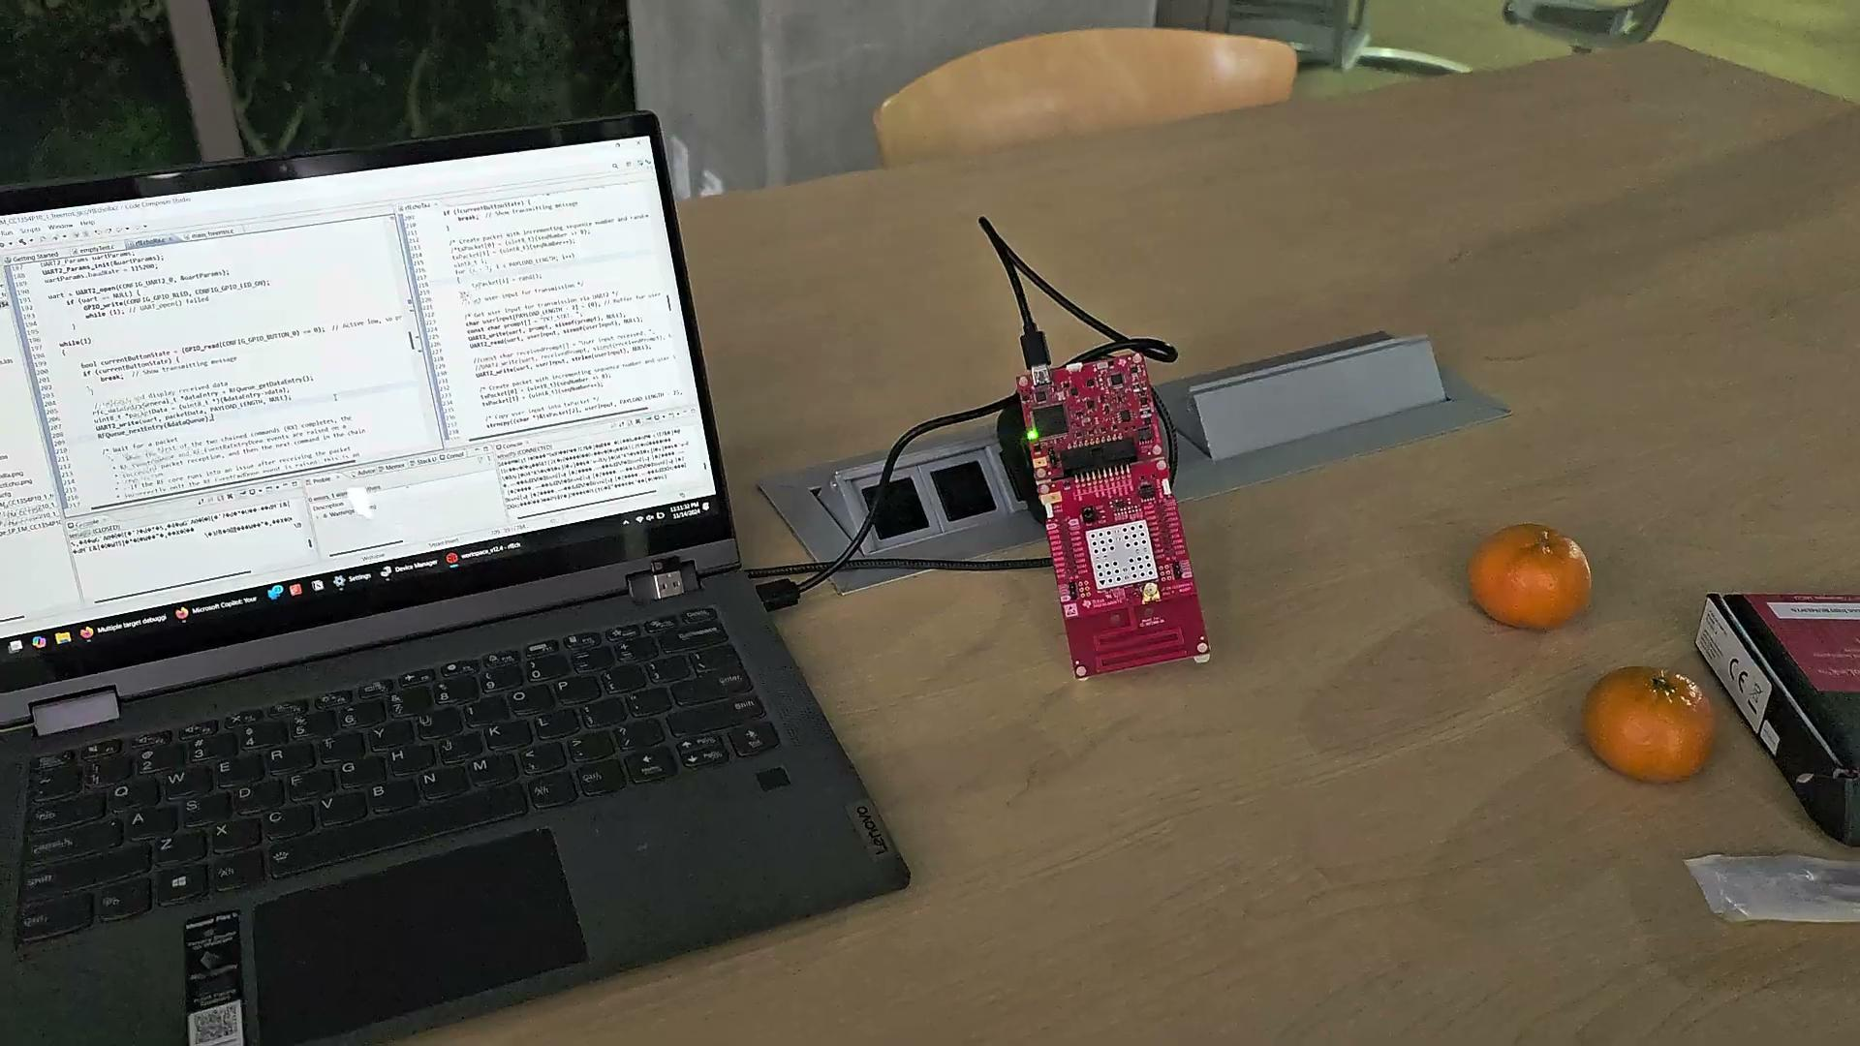
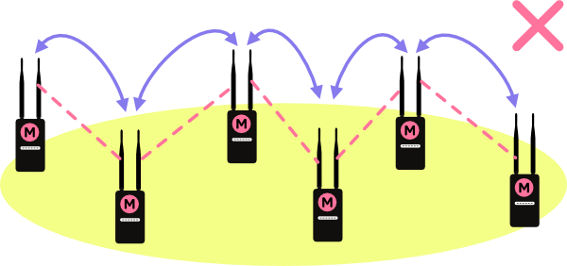
Mesh Connection Subsystem
Cole Cieslewicz
Accomplishments since 403 3 hrs of effort | Ongoing progress/problems and plans until the next presentation
I’ve made sure software is back up and running as expected (as I left it) from 403 demo. | I am going to identify how to migrate from UART text transmission to audio transmission with help of our AudioBoost add-ons and Jaiah’s sub-system.

Slide 9
Power Subsystem
Junsu
Accomplishments since 403 6 hrs of effort | Ongoing progress/problems and plans until the next presentation
Finished PCB design for new converters. Battery charging is still working from last semester. | Finish assembly and validation of new PCB.

Slide 10
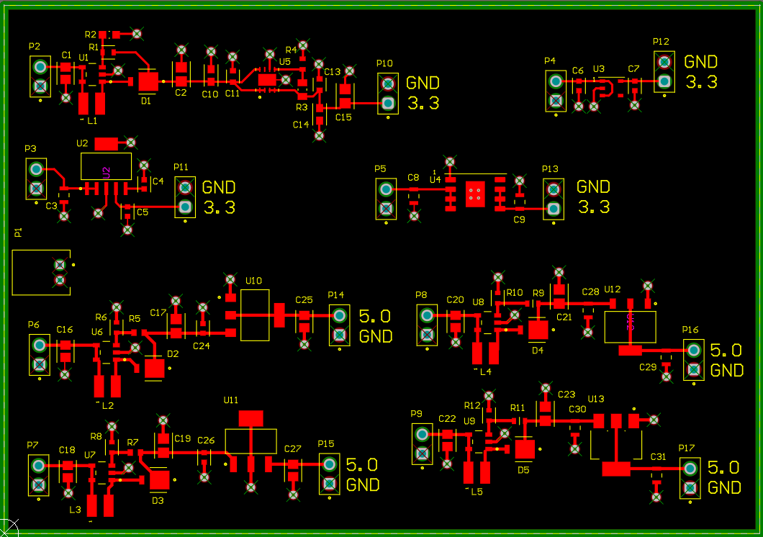
Power System
Junsu Yeo

Slide 11
Parts Ordering Status
New Power PCB | Ordered (Expected within this week)
All components for new PCB | Ordered (Expected within this week)
Speakers | Delivered
LCD’s | Delivered
Microphones | Delivered
915 MHz Radio Antennas | Delivered
TI 3200 AUDBOOST Audio Codec | Requesting from sponsor
Notes:
Michelle

Slide 12
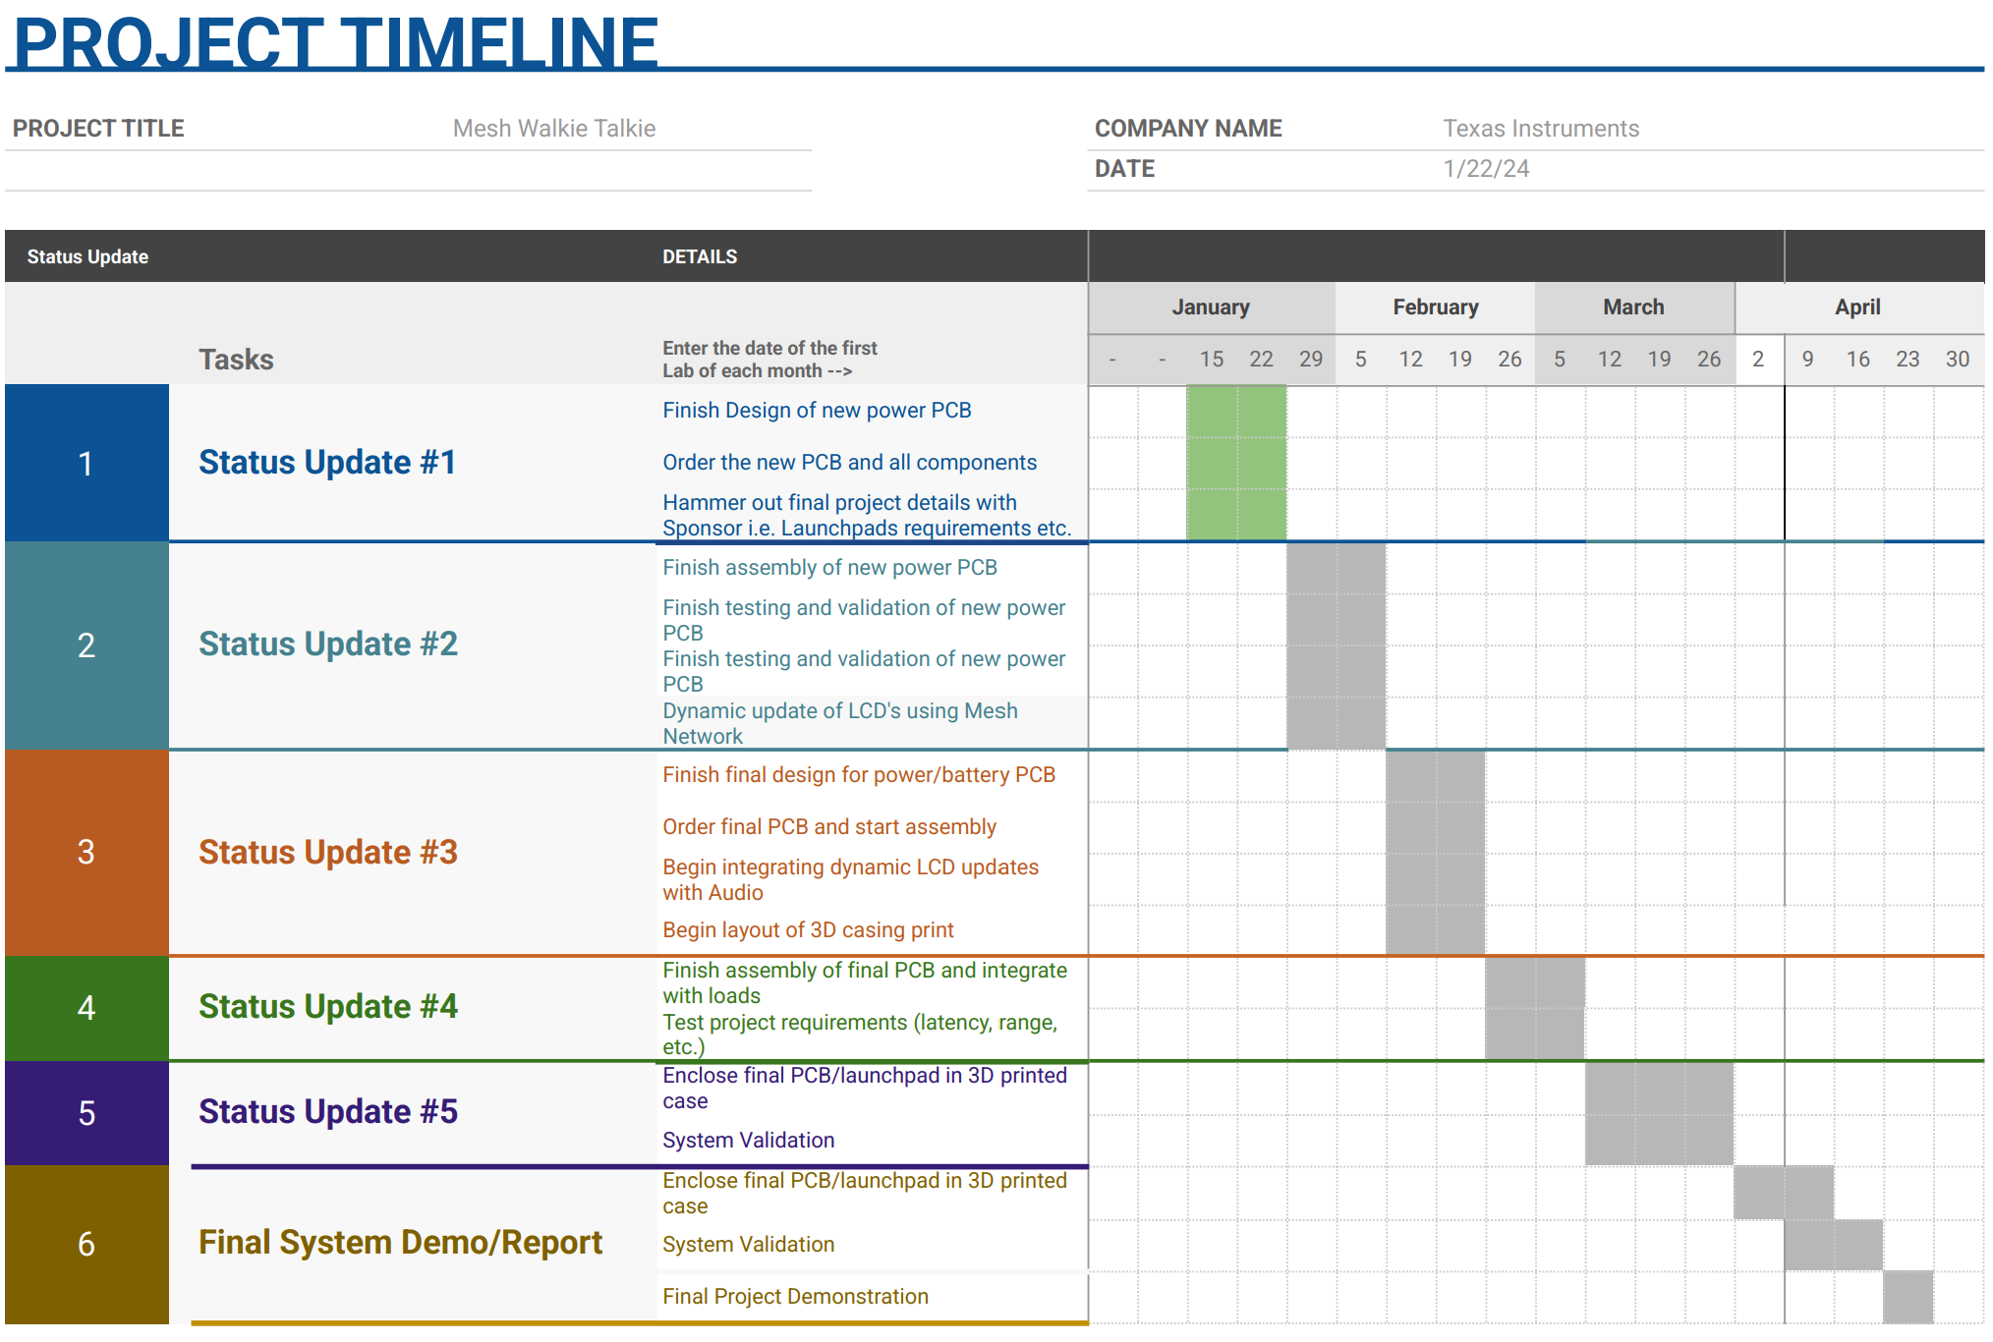
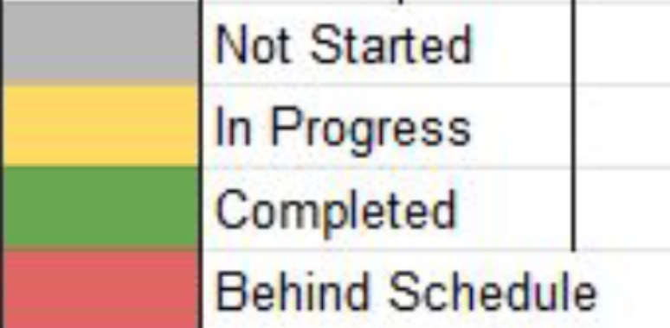
Execution Plan
Notes:
Michelle

Slide 13
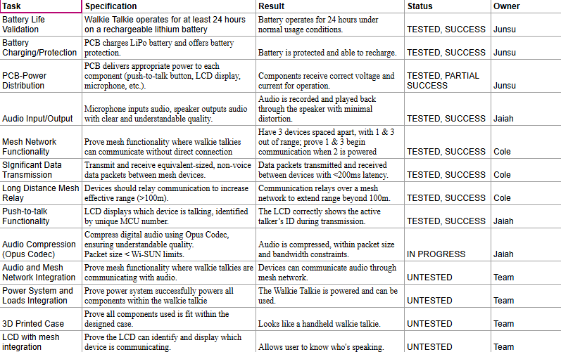
Validation Table

Slide 14
Thank you!

